Slide 1
Machine Learning RIME 831

Slide 2
Administrative
At least 75% attendance policy will be enforced.
Office Location: 417b
Lecture: Monday 6:30 PM to 8:00 PM
Wednesday 5:00 PM to 6:30 PM
Office Hours: email at jawad.khan@smme.nust.edu.pk

Slide 3
Grading Policy
Quizzes 10%
Assignment 10%
MSE 30%
Final Examination 40%
Project 10%

Slide 4
Textbooks
Hands-On Machine Learning with Scikit-Learn, Keras, and TensorFlow: Concepts, Tools, and Techniques to Build Intelligent Systems
Machine Learning, by Tom M. Mitchell, McGraw-Hill Science / Engineering / Math; 1 edition (March 1, 1997). ISBN-10: 0070428077, ISBN-13: 978-0070428072
Bishop, C. M. (2006). Pattern Recognition and Machine Learning. Springer, New York, NY. (Information Science and Statistics series). ISBN: 978-0-387-31073-2.
Adrew Ng Machine learning Course

Slide 5
Pre-requisites
Linear Algebra and Probability
Some Python programming experience and that you are familiar with Python’s main scientific libraries, in particular NumPy, Pandas, and Matplotlib.

Slide 6
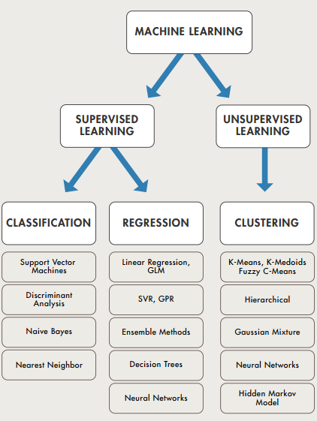
Machine Learning in ONE Image

Slide 7
Tentative Topics
Module 1:
Linear Regression with single and multiple variables
Linear Algebra Review
Matlab Tutorial (optional)
Logistic Regression
Regularization
Neural Networks: Representation
Neural Networks: Learning

Slide 8
Tentative Topics
Module 2:
Convolutional Neural Networks (CNN)
Caffe/Keras deep learning library

Slide 9
Tentative Topics
Module 3:
Support Vector Machines (SVM)
Unsupervised Learning (K-means/GMM)
Dimensionality reduction
Anomaly Detection

